Slide 1
Lecture 12
Artificial Neural Networks (ANNs) Introduction
Dr Samar Hesham
Department of Computer Science Faculty of Computers and Artificial Intelligence
Cairo University
Egypt

Slide 2
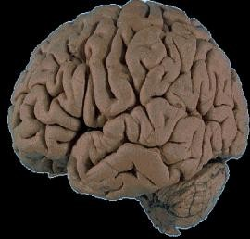
Why we need ANNs?
There are some advanced operations (like face recognition, hand writing recognition … etc) that we can do using our brain, but we don’t know how it is exactly/internally done.
We used to successfully do these operations after sufficient amount of
training and practice.
Unfortunately, it is very hard to try writing such a program that can recognize faces or hand-written text.
Here, the role of the ANNs comes. It mimics the training activities that
are internally done using the Nerve System inside the human brain!
Training occurs through learning from many already-known past examples.
A well-trained ANN will be able to yield correct results for new unknown
problem instances.
ANN

Slide 3

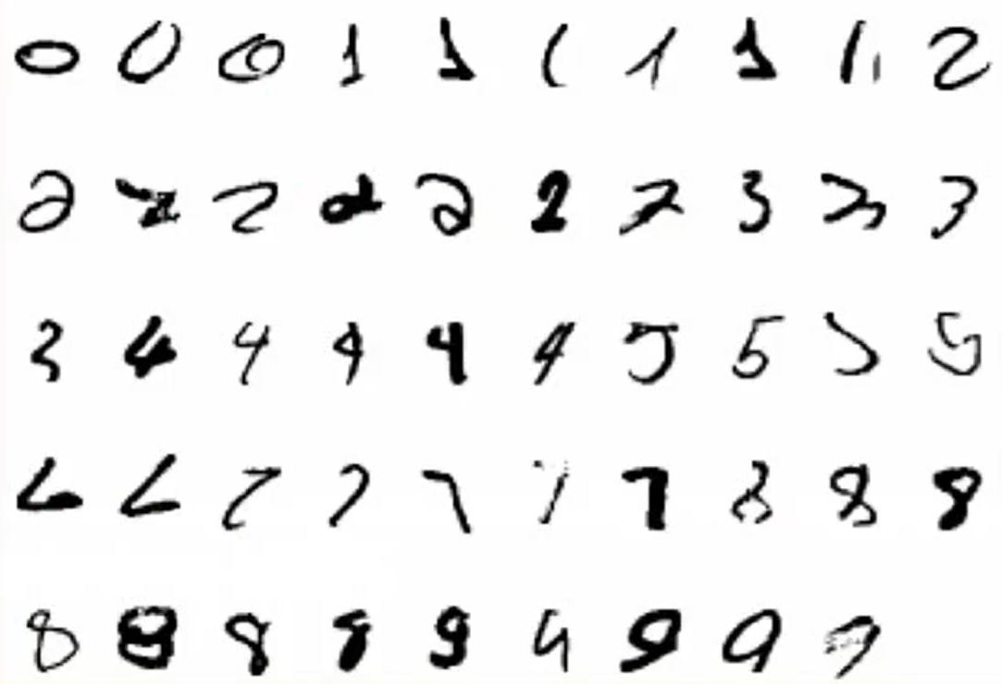
Example: Hand-writing Recognition
It is very hard to develop a program that tells what makes a 2

Slide 4
ANN vs. Computers
Computers have to be explicitly programmed:
Analyze the problem to be solved.
Write the code in a programming language.
Neural networks learn from examples:
No requirements of an explicit description of the problem.
No need for a programmer.
The neural network adapts itself during a training period, based on examples of similar problems even without a desired solution to each problem.
After sufficient training, the neural network is able to relate the problem data to the solutions, inputs to outputs, and it is then able to offer a viable solution to new problems.
Able to generalize or to handle incomplete data.

Slide 5
Definition of Neural Network
Neural network: information processing paradigm inspired by biological nervous systems, such as our brain
A Neural Network is a system composed of many simple processing elements operating in parallel which can acquire, store, and utilize experiential knowledge.
Structure: large number of highly interconnected processing elements (neurons) working together
Like people, they learn from experience (by example)
5

Slide 6
The ANN applications
Classification: the aim is to predict the class of an input vector
Pattern matching: the aim is to produce a pattern best associated with a given input vector
Pattern completion: the aim is to complete the missing parts of a
given input vector
Optimization: the aim is to find the optimal values of parameters in an optimization problem

Slide 7
The ANN applications
Control: an appropriate action is suggested based on given input vectors
Data mining: with the aim of discovering hidden patterns from data (knowledge discovery)
Noise Reduction: removing the non-significant features

Slide 8

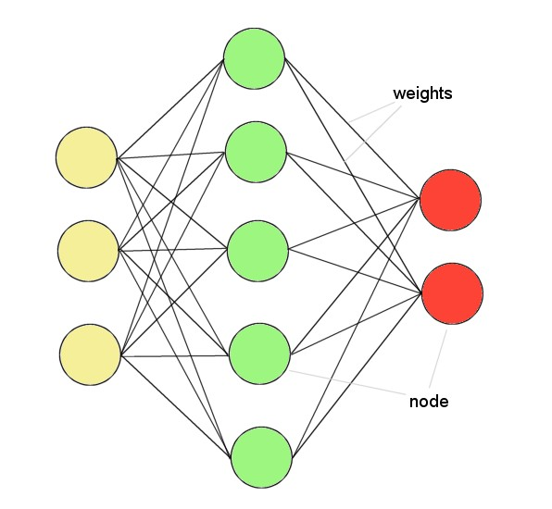
ANNs
ANNs incorporate the two fundamental components of biological neural networks:
Neurons (nodes)
Synapses (weights)
13

Slide 9
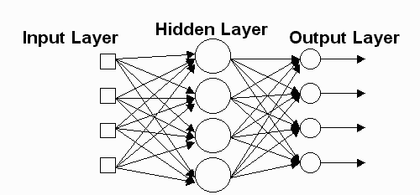
Network Layers
Input Layer - The activity of the input units represents the raw information that is fed into the network.
Hidden Layer - The activity of each hidden unit is determined by:
The activities of the input units and
The weights on the connections between the input and the hidden units.
Output Layer - The behavior of the output units depends on:
The activity of the hidden units and
The weights between the hidden and output units.
9

Slide 10

The Key Elements of Neural Networks
Neural computing requires a number of neurons, to be connected
together into a neural network. Neurons are arranged in layers.
Inputs
Weights
w₁
p₁
p₂
w₂
f
a
Output
w₃
p₃
1
Bias
a = f (p₁w₁ + p₂ w₂ + p₃ w₃ + b)= f (∑ p_{i}w_{i} + b)
Each neuron within the network is usually a simple processing unit which takes one or more inputs and produces an output.
At each neuron, every input has an associated weight which modifies the
strength of each input.
The neuron simply adds together all the inputs and calculates an output to be passed on.
15

Slide 11
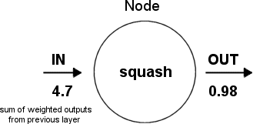
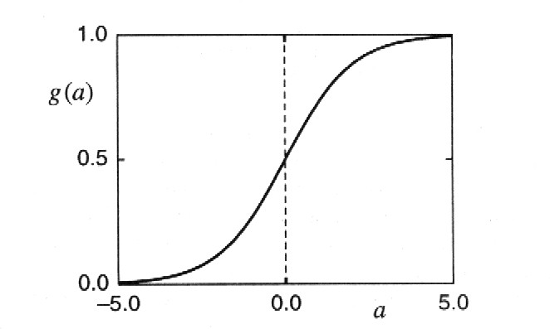
Structure of a node
Squashing/Activation function limits node output:
16

Slide 12
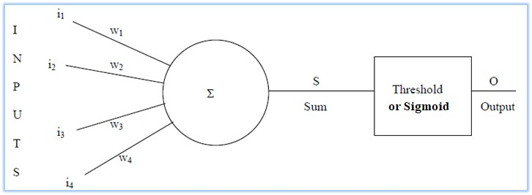
1- Threshold function(Binary step function)
A threshold is then applied, which is a simple binary level:
if S >0.5 then O = 1
if S <0.5 then O = 0
Threshold set at 0.5
So, the neuron takes its inputs, weights them according to how strong the connection is and if the total sum of the weighted inputs is above a certain threshold, the neuron
“fires”.
Output is binary.

Slide 13
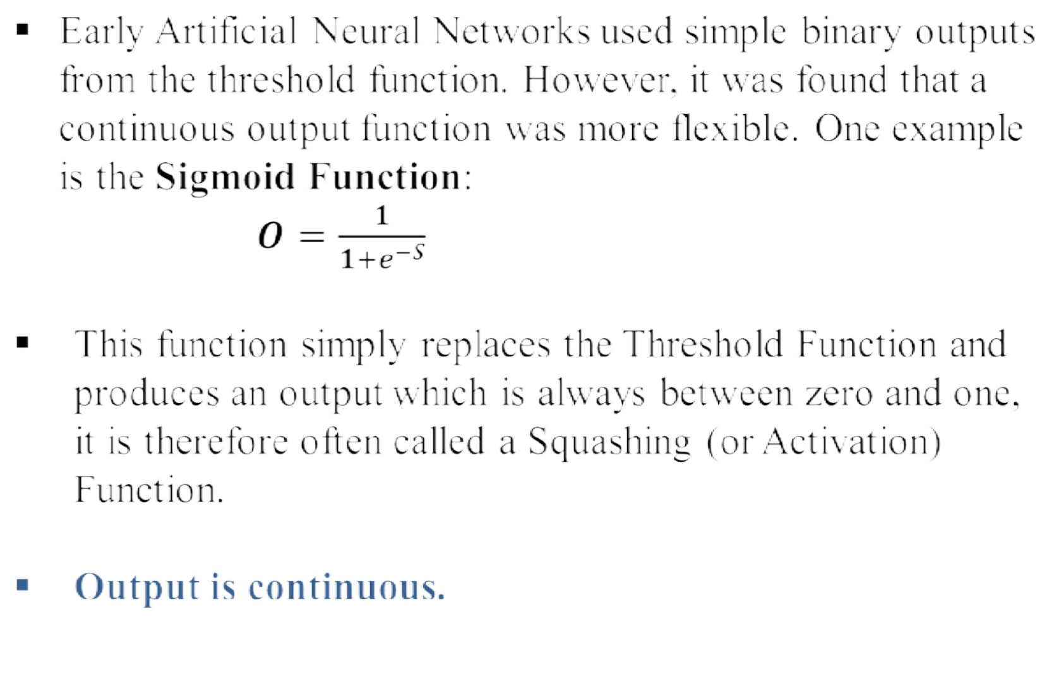

2- Sigmoid function

Slide 14
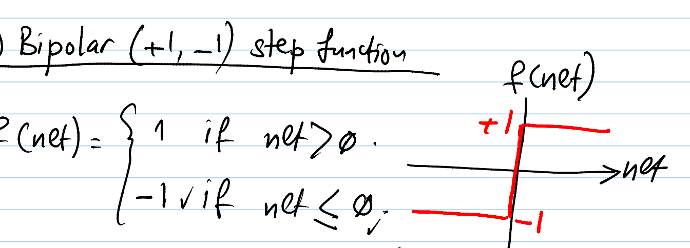
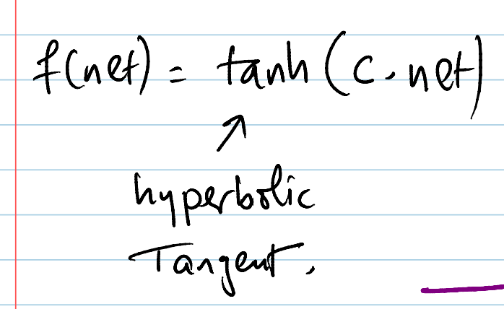







3-Bibolar step function
4. Bipolar sigmoid Function

Slide 15

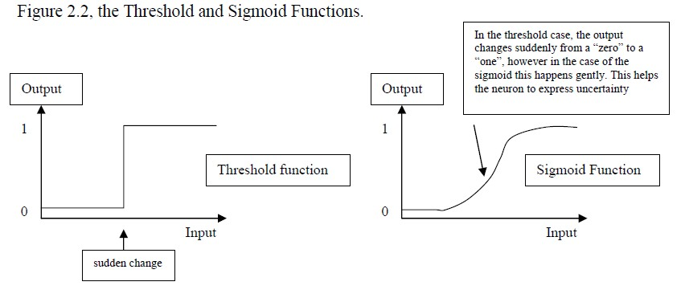
Threshold versus Sigmoid
As we will see later learning occurs by changing the weights interconnecting neurons.

Slide 16
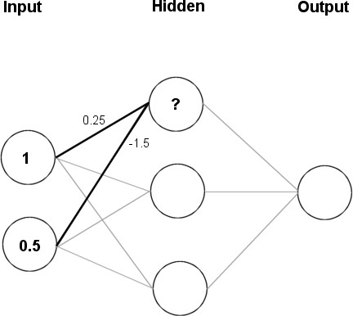


Feeding data through the Network
(1 × 0.25) + (0.5 × (-1.5)) = 0.25 + (-0.75)
= - 0.5
Squashing:
Sigmoid (x) =
1
1+ e^{− x}
1
_{1+ e}0.5
= 0.3775

Slide 17
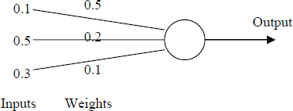

Example
Calculate the output from the neuron below assuming a threshold of 0.5:
Repeat the above calculation assuming that the neuron has a sigmoid output.
12/21/2020
21

Slide 18
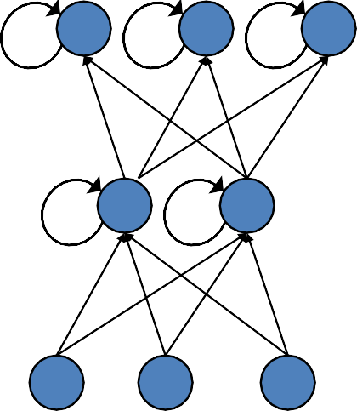
Topologies of Neural Networks
completely connected
feedforward (directed, a-cyclic)
recurrent (feedback connections)
18

Slide 19
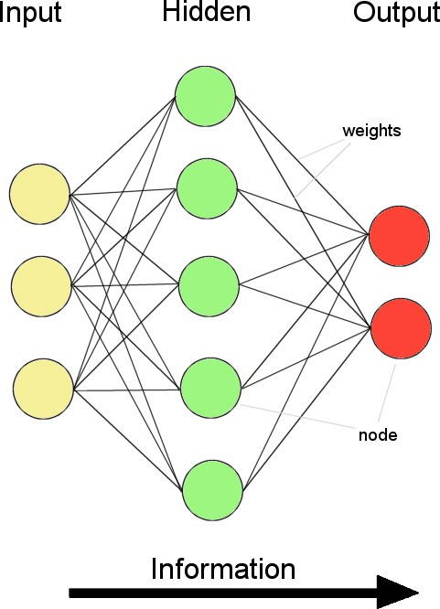
Feed-forward Neural Networks (FFNNs)
Information flow is uni-directional
Data is presented to Input layer Passed on to Hidden Layer Passed on to Output layer
Information is distributed Information processing is parallel
Internal representation (interpretation) of data

Slide 20
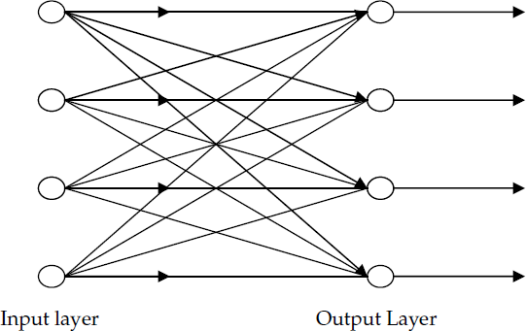
Different types of Neural Networks
Feed-forward Neural Network: (FFNN)
It allows signals to travel one way only; from input to output.
There is no feedback (loops) i.e. the output of
any layer does not affect that same layer.
It tends to be straight forward networks that associate inputs with outputs. They are extensively used in pattern recognition.
This type of organization is also referred to as bottom-up or top-down.
Feedback NN
Single layer FFNN
Multilayer FFNN
Single Layer FFNN
20

Slide 21
Perceptrons
Networks without hidden layer are called perceptrons.
Perceptrons are very limited in what they can represent, but this makes their learning problem much simpler.
Today, used as a synonym for a single-layer feed-forward network.
12/21/2020
Author: Dr. Mohammad Nassef
9

Slide 22
Phases and Data of an ANN
Phases:
Learning (training)
Training can be done using Back-propagation technique (will be seen later).
Training is done using a big part of known (labeled) data.
– The dataset contains both inputs and their corresponding output(s).
This phase is time consuming
Testing
Testing is done using the Feed-forward technique.
A small part of the known data is used in this phase.
Execution
The Feed-forward technique is used.
New unlabeled data (inputs with unknown outputs) are fed to the NN.
Labeled Data:
Data is usually given in one or more consistent dataset(s)
Data is divided into two parts:
One part for the training/learning phase
Another part for the testing phase
14

Slide 23
Example: Pattern Recognition
An important application of neural networks is pattern recognition. Pattern recognition can be implemented by using a feed-forward neural network that has been trained accordingly.
During training, the network is trained to associate outputs with input patterns.
When the network is used, it identifies the input pattern and
tries to output the associated output pattern.
The power of neural networks comes to life when a pattern that
has no output associated with it, is given as an input.
In this case, the network gives the output that corresponds to a taught input pattern that is least different (more similar) from the given pattern.

Slide 24

Pattern Recognition (cont.)
Suppose a network is trained to recognize the patterns T and H. The associated patterns are all black and all white respectively as shown above.

Slide 25

Pattern Recognition (cont.)
Since the input pattern looks more like a ‘T’, when the
network classifies it, it sees the input closely resembling ‘T’ and outputs the pattern that represents a ‘T’.

Slide 26

Pattern Recognition (cont.)
The input pattern here closely resembles ‘H’ with a slight difference. The network in this case classifies it as an ‘H’ and outputs the pattern representing an ‘H’.

Slide 27

Pattern Recognition (cont.)
Here the top row is 2 errors away from a ‘T’ and 3 errors away
from an H. So the top output is a black.
The middle row is 1 error away from both T and H, so the output is random.
The bottom row is 1 error away from T and 2 away from H. Therefore the output is black.
Since the input resembles a ‘T’ more than an ‘H’ the output of the network is in favor of a ‘T’.

Slide 28

Issues to be discussed
Initializing the weights.
Use of a learning algorithm.
Set of training examples.
Encode the examples as inputs.
Convert output into meaningful results.

